Slide 1
TXTLsim-Python
[I’m in search of a better name, please help!]
William Poole
Murray Lab Meeting 10-8-18

Slide 2
Project Overview
A Pythonic (Objected-Oriented and Modular) Version of TXTLsim (MATLAB)
Simple API to compile genetic circuits into chemical reaction networks (CRNs) (as a python object or SBML)
Modular mechanisms for modelling flexibility
Example Mechanisms: Transcription, Translation, Degradation
Support for common biological components
DNA Assemblies [Promoters, RBSs, etc]
Transcription Factor Activation/Repression
Integrases
RNA-Circuitry
Components added together to form a mixture

Slide 3
Object Oriented Architecture
Mixture
Default Mechanisms
Default Components
Components
Component-specific Mechanism “types” inherited from mixture or user-overwritten
Parameters: inherited from the mixture or user-overwritten
Mechanisms
Reaction schemas called by components
Default Parameters
Parameters inherited from components

Slide 4
Object Oriented Architecture: Example
Cell Extract
Mechanisms:
•Transcription
•Translation
•mRNA Degradation
Components
•Ribosomes
•Polymerases
•RNAases
PLac-GFP Assembly
Inherits: Translation, mRNA Degradation
Overwrites: Transcription with Repressed Transcription
Inherits: $k_{tx}$, $k_{tl}$, $δ_{RNA}$
Loads: Promoter and RBS Binding Constants
Inherits: 𝑘_𝑡𝑥, 𝑘_𝑡𝑙, 𝛿_𝑅𝑁𝐴
Loads: Promoter and RBS Binding Constants
Repressed Transcription
Input Species: Gene G, Repressor R, Transcript T
Input Parameters: binding rates, transcription rate
Outputs Reactions:
$$G+nR⇌G:R$$
$G+RNAP ⇌G:RNAP→G+T+RNAP$
Input Species: Gene G, Repressor R, Transcript T
Input Parameters: binding rates, transcription rate
Outputs Reactions:
𝐺+𝑛𝑅⇌𝐺:𝑅
𝐺+𝑅𝑁𝐴𝑃 ⇌𝐺:𝑅𝑁𝐴𝑃→𝐺+𝑇+𝑅𝑁𝐴𝑃
Parameters:
• Machinery Concentrations (e.g. [Ribosome], [RNAP])
• $k_{tx}$, $k_{tl}$, $δ_{RNA}$, etc.
Parameters:
• Machinery Concentrations (e.g. [Ribosome], [RNAP])
• 𝑘_𝑡𝑥, 𝑘_𝑡𝑙, 𝛿_𝑅𝑁𝐴, etc.

Slide 5
Mechanisms are Reaction Schemas
Black Box CRN
Inputs Species and Parameters
Outputs Species
User Specified
User Specified

Slide 6

Transcription Reaction Schema Examples
Stupidly Simple Transcription:
$$G→G+T$$
Gene G
Transcript T

Slide 7
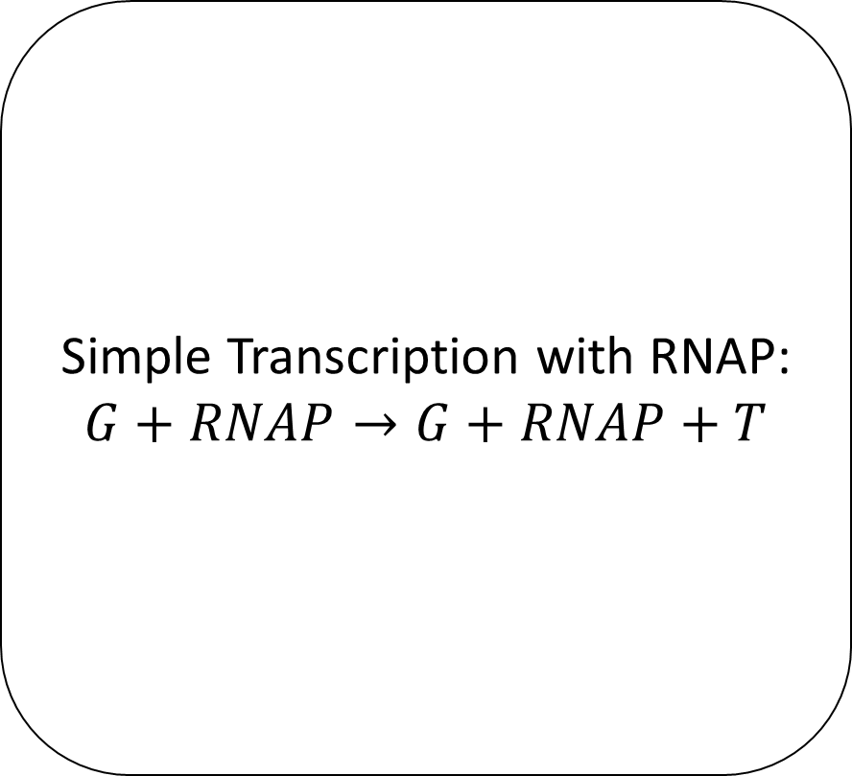
Transcription Reaction Schema Examples
Simple Transcription with RNAP:
$$G+RNAP→G+RNAP+T$$
Gene G
(Optional) RNAP Name
Transcript T

Slide 8
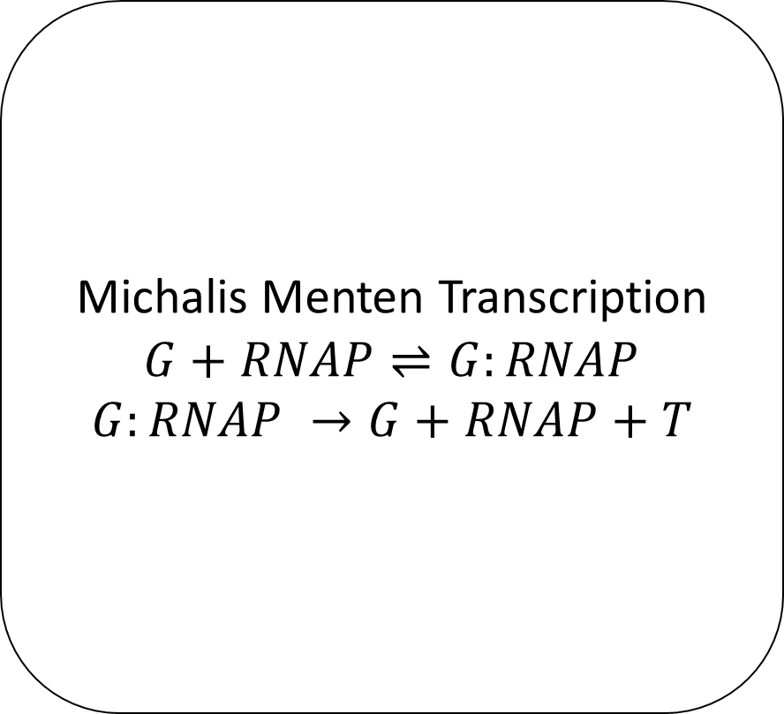
Transcription Reaction Schema Examples
Michalis Menten Transcription
$$G+RNAP⇌G:RNAP$$
$$G:RNAP →G+RNAP+T$$
Gene G
(Optional) RNAP Name
Transcript T

Slide 9
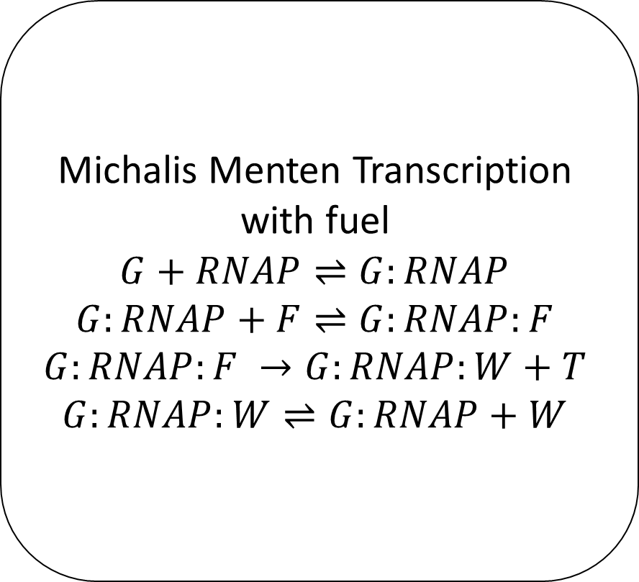
Transcription Reaction Schema Examples
Michalis Menten Transcription with fuel
$$G+RNAP⇌G:RNAP$$
$$G:RNAP+F⇌G:RNAP:F$$
$$G:RNAP:F →G:RNAP:W+T$$
$$G:RNAP:W⇌G:RNAP+W$$
Gene G
(Optional) RNAP Name, Fuel/Waste Names
Transcript T

Slide 10
Mechanism Inheritance
Component Subclasses know their mechanisms
e.g. a Promoter knows it needs ‘transcription’
Mechanism Hierarchy (Higher Takes Precedent)
Custom Component Mechanisms
Default Component Mechanisms
Custom Mixture Mechanisms
Default Mixture Mechanisms

Slide 11
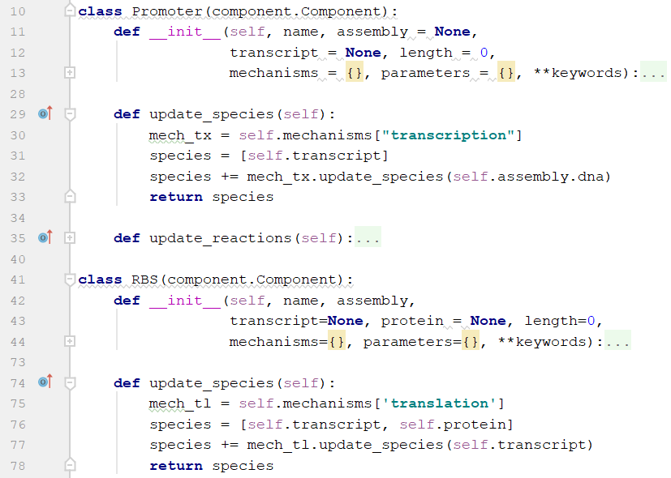
CRN Compilation
Mixture calls update_species() on each of its components.
Each component adds its species representation
eg a DNA construct will be represented by a species dna_[construct name]
Each component calls update_species() for each of its mechanisms
Custom method for each component in order to use reaction schemas
Each mechanism’s update_species() function returns all the species used in its internal CRN
Mixture checks to make sure there are no duplicate species

Slide 12
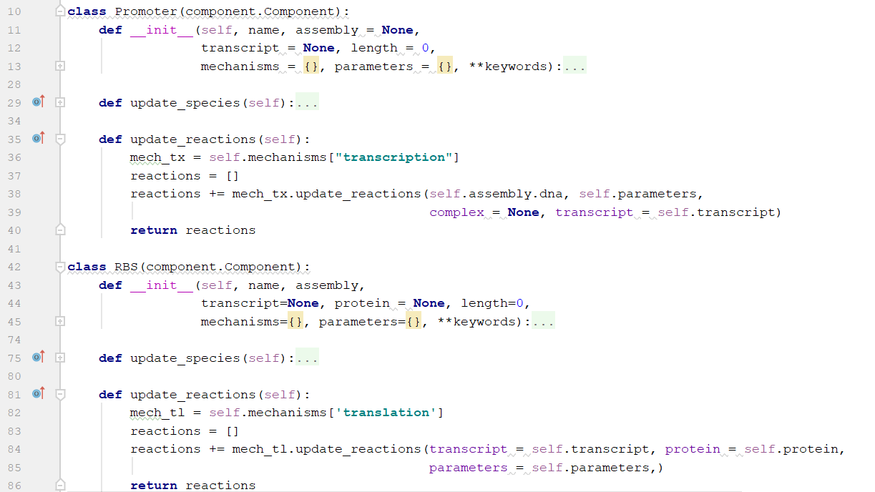
CRN Compilation
Mixture calls update_reactions() on each of its components.
Each component calls update_reactions() for each of its mechanisms
Components never create reactions
Each mechanism’s update_reactions() function returns all the chemical reactions used in its internal CRN
Custom method for each component in order to use reaction schemas
Mixture ensures that no reactions are duplicated

Slide 13
Parameter Structure (still under development)
Inheritance:
Mixture will contain a parameter dictionary
Components default to parameters inherited from their mixture
Components’ custom parameter dictionary overrides the mixture dictionary
Data Sheets:
Components and Mixtures can load parameters from TSVs
Different TSVs could represent different parts or different extract batches.
Multiple parts can be in a single TSV
Parameter values stored using identifiers: (mechanism, part id, param name) => Parameter Value
Unlocated identifiers default hierarchy
(mechanism, part id, param name) > (component, part id, param name) > (mechanism, param name) > (component, param name) … > (param name)

Slide 14
Project Progress
Core Functionality
Core Class Structure
CRN Compilation
CRN Text Representation
CRN Graph Representation
Parameter Loading and Inheritance
Saving CRN to SBML
Rate Functions (as opposed to mass-action)
Documentation and Github
Integration with BioSCRAPE
Add Mixtures Together
Comprehensive Test Cases
Core Component
DNA Assembly
Promoter
RBS
Generic DNA
Generic RNA
Generic Protein
Flippable Assemblies (via integrases)
Proteins with Degradation Tags
Proteins with Maturation Time
Regulated/Inducible Promoters
Combinatoric Promoters
(de)Cas9 and Guide RNAs
Core Mechanisms
Michalis-Menten Transcription (just RNAP)
Michalis-Menten Translation
Michalis-Menten RNA Degradation
Sigma Factor Transcription
Transcription with Fuel
Translation with Fuel
Linear DNA Degradation
GamS Protection
Transcription Factor Regulated Transcription (with/without Cross Talk)
Sense-Antisense RNA Regulated Transcription (with/without Cross Talk)
Integrases
(de)Cas9 DNA Binding
Protein Degradation (with and without fuel)

Slide 15
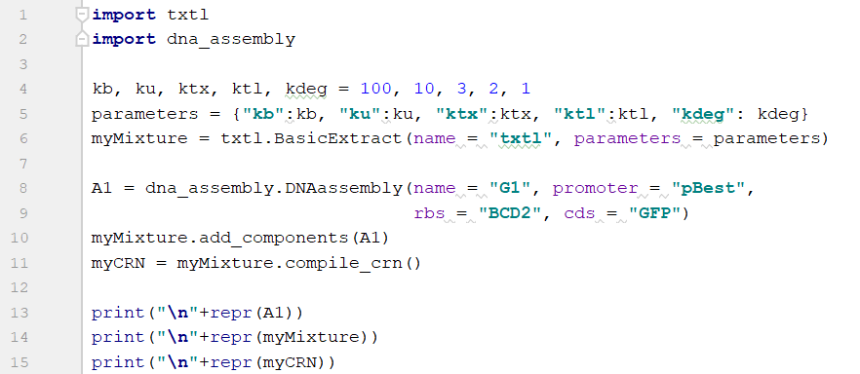
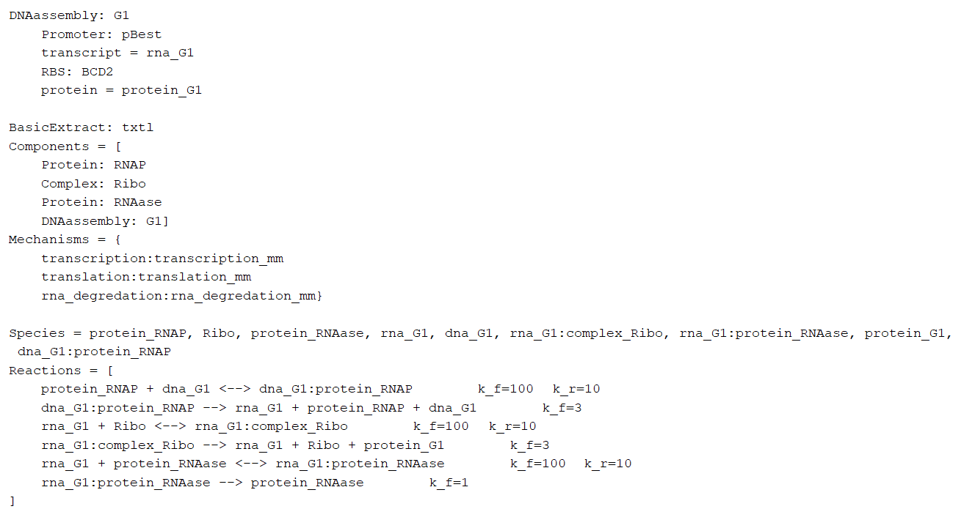
Constitutive Expression Demo

Slide 16

Retroactivity Demo: Background
Gene
mRNA
Protein
Resource Competition
Downregulates
Polymerase
Sigma Factors
Resource Competition
Upregulates
Resource Competition
Downregulates
Ribosomes
Endonucleases
Polymerase
Sigma Factors
$$∅$$
Ribosomes
Endonucleases
Gene
mRNA
Protein

Slide 17
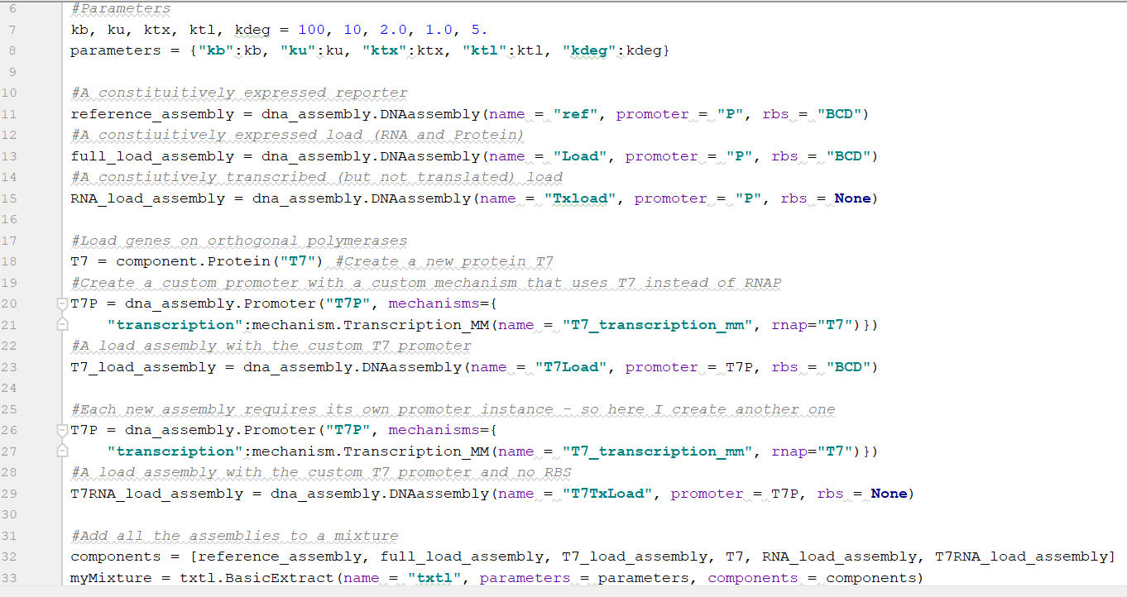
Retroactivity Demo
~15 lines of code without comments (including imports)

Slide 18
Retroactivity Demo
The CRN contains 30 Species and 26 Reactions
(reversible reactions counted just once)
Species = dna_ref, rna_ref:complex_Ribo, dna_ref:protein_RNAP, rna_ref:protein_RNAase, rna_ref, protein_ref, dna_Load, dna_Load:protein_RNAP, rna_Load, rna_Load:complex_Ribo, rna_Load:protein_RNAase, protein_Load, dna_T7Load, rna_T7Load:protein_RNAase, protein_T7Load, dna_T7Load:protein_T7, rna_T7Load:complex_Ribo, rna_T7Load, protein_T7, rna_Txload:protein_RNAase, dna_Txload:protein_RNAP, dna_Txload, rna_Txload, rna_T7TxLoad, dna_T7TxLoad:protein_T7, dna_T7TxLoad, rna_T7TxLoad:protein_RNAase, protein_RNAP, Ribo, protein_RNAase
Reactions = [
protein_RNAP + dna_ref <--> dna_ref:protein_RNAP k_f=100 k_r=10
dna_ref:protein_RNAP --> rna_ref + protein_RNAP + dna_ref k_f=2.0
rna_ref + Ribo <--> rna_ref:complex_Ribo k_f=100 k_r=10
rna_ref:complex_Ribo --> rna_ref + Ribo + protein_ref k_f=2.0
protein_RNAase + rna_ref <--> rna_ref:protein_RNAase k_f=100 k_r=10
rna_ref:protein_RNAase --> protein_RNAase k_f=5.0
dna_Load + protein_RNAP <--> dna_Load:protein_RNAP k_f=100 k_r=10
dna_Load:protein_RNAP --> dna_Load + protein_RNAP + rna_Load k_f=2.0
rna_Load + Ribo <--> rna_Load:complex_Ribo k_f=100 k_r=10
rna_Load:complex_Ribo --> rna_Load + protein_Load + Ribo k_f=2.0
rna_Load + protein_RNAase <--> rna_Load:protein_RNAase k_f=100 k_r=10
rna_Load:protein_RNAase --> protein_RNAase k_f=5.0
dna_T7Load + protein_T7 <--> dna_T7Load:protein_T7 k_f=100 k_r=10
dna_T7Load:protein_T7 --> dna_T7Load + protein_T7 + rna_T7Load k_f=2.0
Ribo + rna_T7Load <--> rna_T7Load:complex_Ribo k_f=100 k_r=10
rna_T7Load:complex_Ribo --> protein_T7Load + Ribo + rna_T7Load k_f=2.0
protein_RNAase + rna_T7Load <--> rna_T7Load:protein_RNAase k_f=100 k_r=10
rna_T7Load:protein_RNAase --> protein_RNAase k_f=5.0
protein_RNAP + dna_Txload <--> dna_Txload:protein_RNAP k_f=100 k_r=10
dna_Txload:protein_RNAP --> protein_RNAP + dna_Txload + rna_Txload k_f=2.0
protein_RNAase + rna_Txload <--> rna_Txload:protein_RNAase k_f=100 k_r=10
rna_Txload:protein_RNAase --> protein_RNAase k_f=5.0
protein_T7 + dna_T7TxLoad <--> dna_T7TxLoad:protein_T7 k_f=100 k_r=10
dna_T7TxLoad:protein_T7 --> rna_T7TxLoad + protein_T7 + dna_T7TxLoad k_f=2.0
rna_T7TxLoad + protein_RNAase <--> rna_T7TxLoad:protein_RNAase k_f=100 k_r=10
rna_T7TxLoad:protein_RNAase --> protein_RNAase k_f=5.0
]

Slide 19
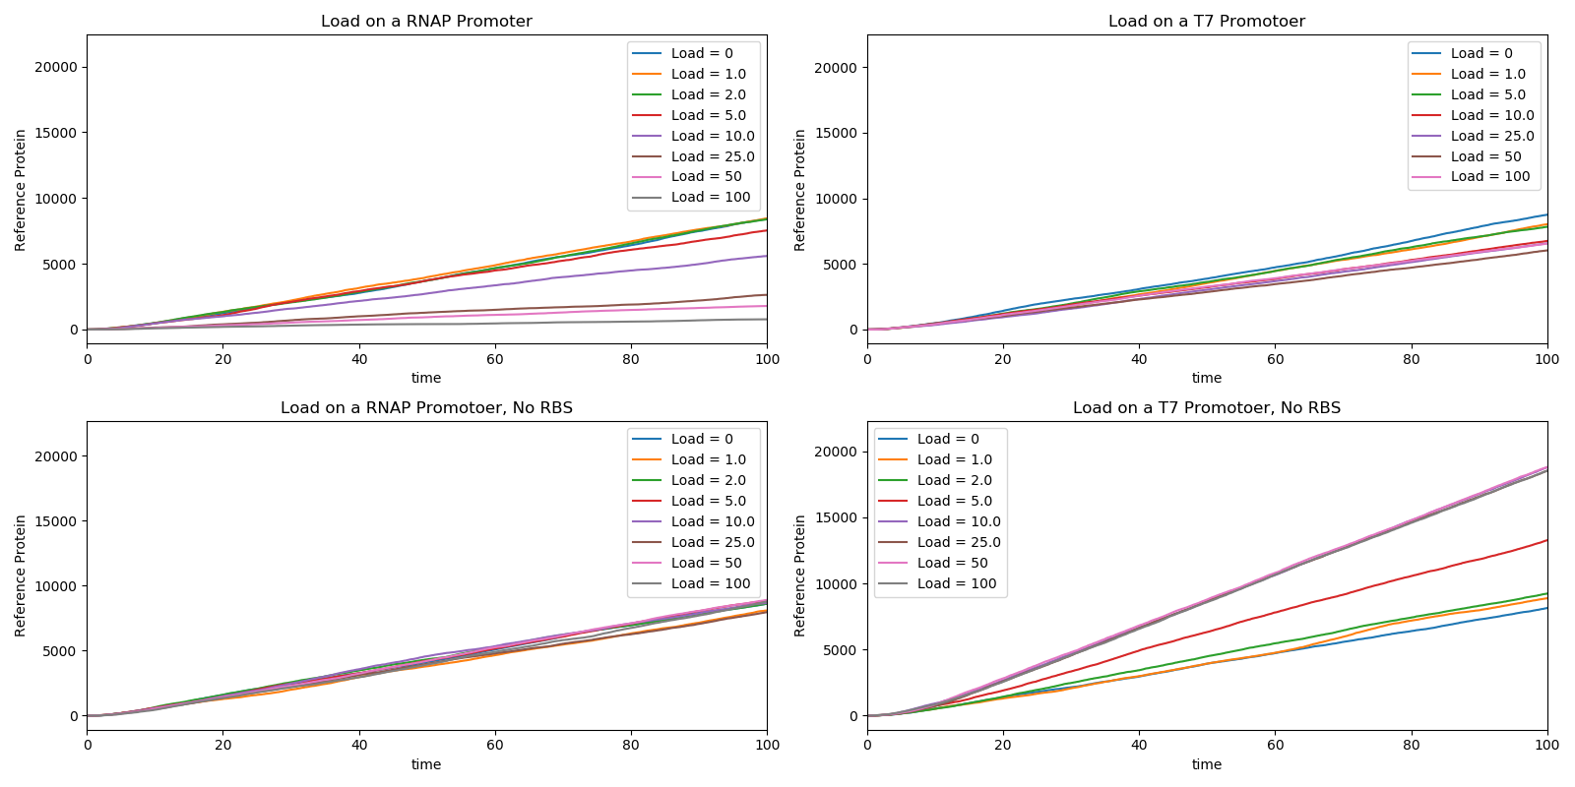
Retroactivity Demo
Stochastic simulations of each load assembly with the reference assembly
#ref_dna = 5, #polymerase = 10, #ribosomes = 100, #RNAase = 5

Slide 20
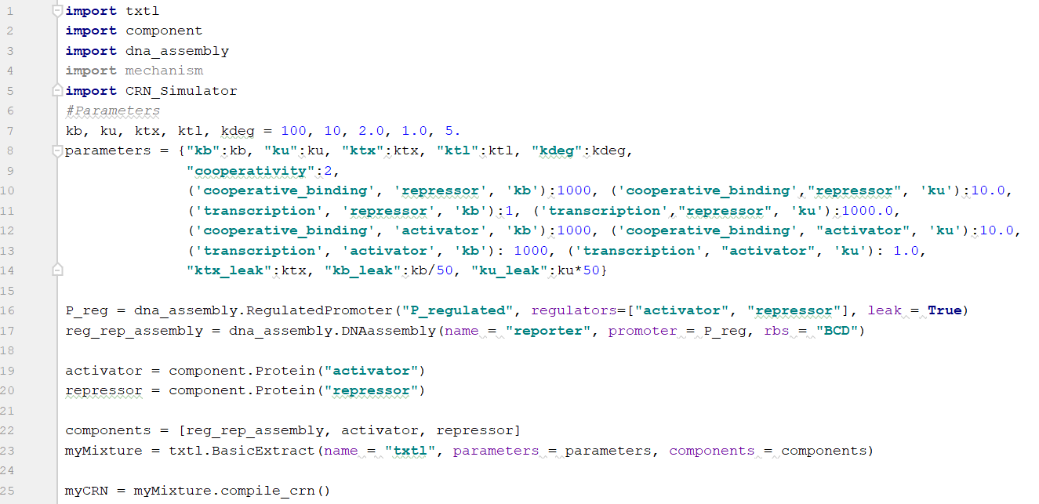
Activation/Repression Demo

Slide 21
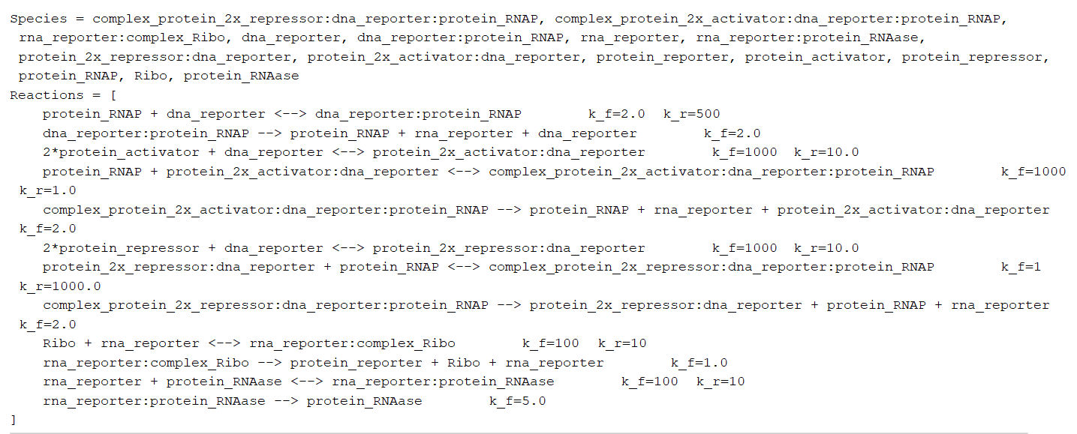
Activation/Repression Demo

Slide 22
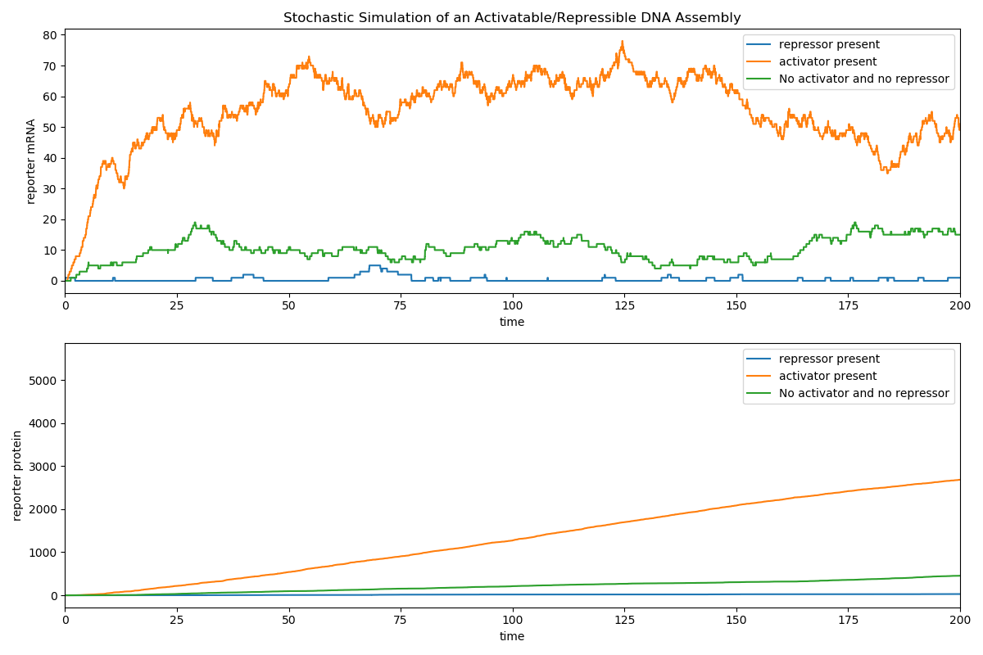
Activation/Repression Demo

Slide 23
Questions? Feature Requests? Package Name Suggestions?
Core Functionality
Core Class Structure
CRN Compilation
CRN Text Representation
CRN Graph Representation
Parameter Loading and Inheritance
Saving CRN to SBML
Rate Functions (as opposed to mass-action)
Documentation and Github
Integration with BioSCRAPE
Add Mixtures Together
Comprehensive Test Cases
Core Components
DNA Assembly
Promoter
RBS
Generic DNA
Generic RNA
Generic Protein
Flippable Assemblies (via integrases)
Proteins with Degradation Tags
Proteins with Maturation Time
Regulated/Inducible Promoters
Combinatoric Promoters
(de)Cas9 and Guide RNAs
Core Mechanisms
Michalis-Menten Transcription (just RNAP)
Michalis-Menten Translation
Michalis-Menten RNA Degradation
Sigma Factor Transcription
Transcription with Fuel
Translation with Fuel
Linear DNA Degradation
GamS Protection
Transcription Factor Regulated Transcription (with/without Cross Talk)
Sense-Antisense RNA Regulated Transcription (with/without Cross Talk)
Integrases
(de)Cas9 DNA Binding
Protein Degradation (with and without fuel)

